Slide 1
Psychological Strategies to enhance performance and recovery

Slide 2
Sports Psychology
Sports psychology is the sports science that seeks to understand psychological and mental factors that affect performance in sports, and apply these to improve performance.

Slide 3
‘There are four major performance skills for all elite sportsmen and women, these being technical, physical, tactical and mental. The latter skill is one that can make the crucial difference for athletes performing consistently to their abilities. Sport psychology has played a significant role in the understanding, training and ultimately the use of mental skills for peak performance.’
John Buchanan, former coach of the Australian cricket team
Source: Australian Psychological Society Ltd.

Slide 4
Control
Control - the ability to maintain emotional control regardless of distraction
An athlete's ability to maintain control of their emotions in the face of pressure or adversity and remain positive is essential to successful performance.
Performance (or competitive) anxiety and arousal levels are two emotional control factors that can impact on performance.

Slide 5
Performance anxiety
Anxiety is an emotional state with heightened arousal.
Anxiety can affect an athletes physical or mental state and decrease performance
Physical (or somatic) anxiety — butterflies, sweating, nausea, needing to go to the toilet
Mental (or cognitive) anxiety — worrying, negative thoughts, confusion, lack of concentration.

Slide 6
Factors affecting anxiety
The importance of the event – bigger compeition = more nerves. Olympics vs Fun Run
Level of spectator support – “home ground advantage”
Individual sports versus team sports – individual sports suffer more anxiety than team sports due to isolation and exposure.
Expectation of success – if you are expected to win can increase anxiety

Slide 7
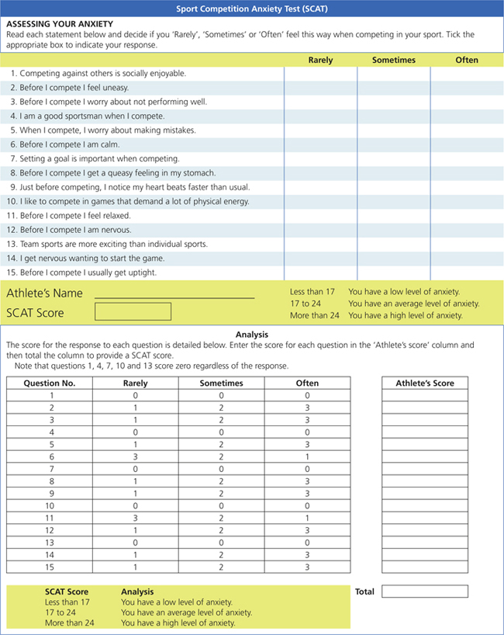

Slide 8
Arousal and Performance
Arousal – is the readiness an athlete experiences when faced with a task.
Continuum from sleep to hyperactive.

Slide 9
Inverted U Hypothesis
The inverted-U hypothesis predicts that the relationship between arousal and performance approximates an inverted-U shape.
The theory is that as arousal increases performance improves, but only up to a certain point
If the athlete's arousal is increased beyond this point then performance diminishes. A moderate degree of arousal is seen as being optimal to performance.

Slide 10
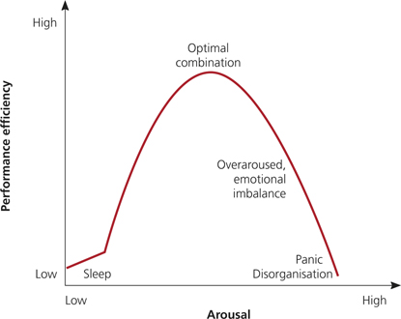

Slide 11
Other theories
Catastrophe theory
Optimum arousal theory
Multidimensional arousal–anxiety theory

Slide 12
Techniques to increase or decrease arousal levels
Progressive muscle relaxation (PMR)
Athletes undergo a series of exercises that lead to progressive muscle relaxation and eventually total body relaxation.
This technique is based on the simple premise of tensing one muscle group at a time, followed by a release of the tension.
Through repetitive practice athletes quickly learn to recognise and distinguish between the associated feelings of a tensed muscle and a completely relaxed muscle.
With this simple knowledge, they can then induce physical muscular relaxation at the first signs of the tension that accompanies over-arousal and associated anxiety.
This physical relaxation can then help to induce a state of mental relaxation and calmness in many situations.

Slide 13
Centred breathing
The technique of breathing to release tension and anxiety can be used before or during performance. This technique helps the athlete to focus while they are preparing for the next action.

Slide 14
Meditation
Meditation involves focusing the mind on a particular thing for a certain period of time. It can involve using a mantra (repeating a calming word or sound), or using blank meditation. Meditation is used to help reduce stress before an event. The aims of this technique are to calm the mind and relax the body.

Slide 15
Reading your body
Athletes can learn to recognise cues that inform them of their readiness for competition.
These may be physical indicators such as heart rate and breathing rate, or mental cues such as attention and concentration levels.

Slide 16
Pre-competition ‘psyche up’
Athletes raise their arousal levels to desired performance levels before competition through the use of warm-up exercises such as shadow boxing, motivational addresses, music and video footage.
http://www.youtube.com/watch?v=myyWXKeBsNk

Slide 17
Concentration
Concentration is the ability to focus on the task and ignore distractions.
http://www.youtube.com/watch?v=WF8KJZev7u0
Being able to focus can be a major part of performance.
Distractions may include; anxiety, mistakes, fatigue, crowd, opponents “sledging”.
Athletes can improve their level of attention by assessing the attentional strengths and weaknesses of the athlete and the demands of the sport.

Slide 18
Strategies for improving concentration and attention
centred breathing
mental imagery and rehearsal (visualisation)
positive self-talk and cue words (practise using words such as ‘relaxed hands’, ‘knees together’)
utilising a clear pre-performance routine. This is seen when golfers follow a set routine before driving off the tee

Slide 19
Mental Imagery
Mental Imagery (visualisation) involves Think about performing a skill without actually moving.
Is one of the oldest and simplest ways of improving performance psychologically.

Slide 20
Types of mental imagery
mental practice — used for a specific movement or skill, such as a penalty kick in soccer.
mental rehearsal — used for a complete athletic performance. The athlete must create as detailed an image as possible, and visualise themselves performing flawlessly in a game environment.
mental review — used to recount a past performance. It is important for the athlete to learn from any negative aspects, yet move past them to focus on positive results.
self-affirmation — used to improve self-confidence by imagining successful performances.

Slide 21
Your Turn!
Define sports psychology.
Briefly explain each of the four Cs used in sports psychology.
.

Slide 22
Name two emotional control factors that can impact on performance.
Identify and provide examples of the ways performance anxiety can manifest itself.
.

Slide 23
Explain the inverted-U hypothesis. Include a diagram.

Slide 24
List common distractions that can affect an athlete's ability to concentrate.
Suggest ways coaches can assist athletes to improve their level of concentration.
.

Slide 25
Describe each of the techniques that can be used to control performance anxiety and arousal.
Identify the techniques that involve the use of mental imagery and provide detailed examples for each technique.
.

Slide 26
Pre-performance routines have been identified as a strategy to assist an athlete's concentration. Choose three sports and describe a pre-performance routine that may be used in each of those sports.
Do Sport Competition Anxiety Test on eBookplus Searchlight ID: doc-2913

Slide 27
Confidence
Self confidence is what an individual has when they think they can successfully complete a task. They will
  persevere even when things are not going to plan
  show enthusiasm and motivation
  be positive in their approach and take their share of the responsibility in success and failure.

Slide 28
Confidence can be lost when athletes start focusing on things that are outside their control such as other competitors performances or become overly critical of themselves, this can often be reffered to as choking.
They can lose focus, increase HR, muscle tension and develop anxiety about the skill.
Extra reading “Kicking at goal all in the mind”

Slide 29
Commitment
Successful sports performance depends on the athlete being fully committed and motivated towards achieving their goals.
Motivation may be defined as ‘the causes of the initiation, maintenance and intensity of behaviour’.
Motivation is a reason for participating in an activity, learning the skills involved, training and practising, and dedicating effort to improvement.

Slide 30
Athletes with high levels of motivation often exhibit the following characteristics:
  a desire for success
  a willingness to take risks
  an acknowledgement of their own ability as crucial to their success
  an ability to increase their effort and concentration as the task difficulty increases.

Slide 31
Goal setting
Goal setting is an extremely effective motivational technique.
However to be a successful tool they need to be applied properly.
A good way to ensure this happens is by applying a SMARTER principle when setting goals.

Slide 32
SMARTER
Specific — athletes and coaches should make their goals as specific and detailed as possible.
Measurable — goals should be measurable and assessed against a standard or previous performance, otherwise there is no way of determining whether or not they were achieved.
Accepted — all of the parties involved in the setting of the goals (e.g. the athlete, coach, manager, family members) should accept them.
Realistic — goals need to be challenging, but also achievable. Goals should be framed in a positive manner and focused most importantly on improvement, rather than just on winning.
Timeframed — short-term and long-term goals should be set and there should be a specific date for when they will be achieved.
Exciting — the goals set should challenge, excite and inspire the athlete.
Recorded — the agreed goals should be recorded by the coach and the athlete so as to provide a constant reminder and to act as a source of motivation.

Slide 33
Your turn!
Have a go at the applying the SMARTER principle for yourself on the handout provided by Mr Saunders.

Slide 34
Intrinsic vs Extrinsic Motivation
Intrinsic motivation comes from within and occurs when factors such as enjoyment, satisfaction, improvement and enhanced feelings of self-worth are the primary motivation for performance.
Extrinsic motivation has an external focus and usually involves some form of material benefit such as financial reward (prize money), awards and trophies, glory and recognition.

Slide 35
Most researchers agree that intrinsic motivation to perform is more desirable than extrinsic motivation, as it will serve as a more powerful and sustainable source of motivation.

Slide 36
Your turn!
Define confidence.
Describe choking and identify reasons why athletes might choke during critical moments in performance.
,

Slide 37
Describe ways an athlete can improve their confidence.
List the characteristics of a highly motivated athlete.
.

Slide 38
Explain the acronym SMARTER and what it relates to.
Outline the difference between intrinsic and extrinsic motivation. Provide examples.

