Slide 1
Strategies to enhance performance and recovery

Slide 2
Key Knowledge
Nutritional strategies used to enhance performance and improve recovery including carbohydrate loading, application of the glycaemic index, carbohydrate gels, and protein supplementation

Slide 3
Key Skills
Compare and contrast practices designed to enhance performance and/or speed up recovery
Analyse and evaluate nutritional and hydration procedures used to enhance individual performance and recovery
Participate in and evaluate a range of nutritional, physiological or psychological strategies that potentially enhance performance and aid recovery

Slide 4
Nutritional needs of an athlete – Balanced diet
We all need some of the following nutrients
carbohydrates
fats
proteins
vitamins
minerals
water
fibre.

Slide 5
Planning your diet
achieve optimum intake of all nutrients specific to their sport and their own sporting needs
ensure recovery between training sessions and after competition
account for any special dietary requirements for the event and/or themselves
make their plan enjoyable and suitable to their tastes and training regime
drink plenty of fluid.

Slide 7
Carbohydrates
Carbohydrates are our bodies preffered energy source during exercise.
What energy systems and activities use carbohydrates as a fuel source?

Slide 8
Situation | Recommended carbohydrate intake
Daily refuelling needs for training programs less than 60–90 minutes per day or low-intensity exercise | Daily intake of 5–7 grams per kilogram BM
Daily refuelling for training programs greater than 90–120 minutes per day | Daily intake of 7–10 grams per kilogram BM
Daily refuelling for athletes undertaking an extreme exercise program: 6–8 hours per day (cycling tour) | Daily intake of 10–12+ grams per kilogram BM
Carbohydrate loading for endurance and ultra-endurance events (see section 10.4) | Daily intake of 7–10 grams per kilogram BM
Pre-event meal (meal eaten 1–4 hours pre-competition) | 1–4 grams per kilogram BM
Carbohydrate intake during training sessions and competition events longer than 1 hour | 1 gram per minute or 30–60 grams per hour
Rapid recovery after training session or multi-day competition, especially when there is less than 8 hours until next session | Intake of 1–1.5 grams per kilogram BM for every hour in the early stages of recovery after exercise, contributing to a total intake of 6–10 grams per kilogram BM over 24 hours

Slide 9
How much carbs should you have?
Using previous slide work out the amount of carbohydrates you should be eating a day

Slide 10
Low GI vs High GI
Glycaemic Index refers to how much different types of carbohydrates raise blood-glucose levels.
The higher the GI the more quickly it is digested and a quicker rise in blood glucose is shown.

Slide 12
How can GI knowledge help?
You can plan when you eat what type of carbohydrates during the day to optimise their availability when we need them for fuel.
It is undecided if eating a low GI meal prior to endurance events is beneficial.
Athletes can also use carbohydrate supplements during an event.
Some athletes cannot eat close to an event, rebound hypoglycaemia.

Slide 13
What will help?
The athlete should ingest carbohydrates as soon as they can after the event and maintain a high carbohydrate intake for the next 24 hours.
The first 15–30 minutes post exercise are considered to be vital in terms of carbohydrate replenishment. The athlete should consume 50–100 grams of carbohydrates with a high glycaemic index within the first 15–30 minutes post exercise.
Over the next 2 hours the athlete should consume 25–50 grams of moderate to high glycaemic index carbohydrate foods every 15 minutes.
The athlete should consume 10–12 grams of carbohydrates per kilogram of body weight over the next 24 hours post exercise. It is generally recommended that more complex carbohydrates with a low to moderate glycaemic index be consumed during this period.

Slide 14
Carbohydrate Gels

Slide 16
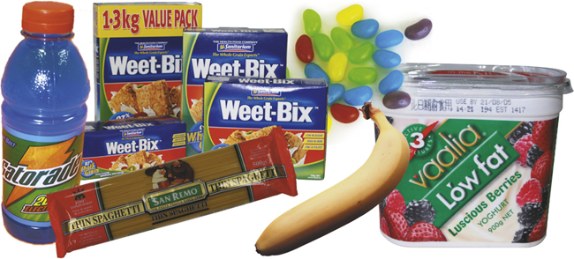
High, Moderate or Low GI?

Slide 17
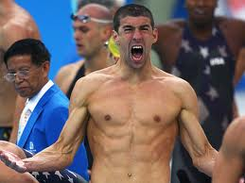
Michael Phelps diet!
Michael Phelps made headlines during the Beijing Olympics when his diet was revealed:
Breakfast: Three sandwiches with fried eggs, cheese, lettuce, tomatoes, fried onions, mayonnaise; three chocolate-chip pancakes; an omelette made of five eggs; three sugar-coated pieces of French toast; a bowl of grits; two cups of coffee
Lunch: Half a kilogram of pasta, two ham, cheese and mayonnaise sandwiches; energy drinks (about 1000 calories)
Dinner: Half a kilogram of pasta; a large pizza; energy drinks (about 1000 calories)

Slide 18
Review Michael's diet and comment on the following.
Is this a balanced diet?
What are the nutritional benefits Michael would gain from this diet?
What is the suitability of this diet for an average athlete?
What changes or alterations would you make to his diet?

Slide 19
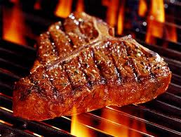
Protein!

Slide 20
What does protein do again?
formation and growth of body tissues, especially muscle tissue and cells
repair and recovery of damaged tissues such as muscle tissue
production of red blood cells, hormones, antibodies and enzymes
provision of emergency fuel during exercise when carbohydrate and fat stores are depleted.

Slide 21
*Exercising approximately four to five times per week for 45–60 minutes **Exercising four to five times per week for 30 minutes at < 55 per cent VO₂ max
Group | Protein intake ( g/kg/day)
*Exercising approximately four to five times per week for 45–60 minutes **Exercising four to five times per week for 30 minutes at < 55 per cent VO₂ max
Sedentary men and women | 0.8–1.0
Elite male endurance athletes | 1.6
Moderate-intensity endurance athletes* | 1.2
Recreational endurance athletes** | 0.8–1.0
Football players, power sports athletes | 1.4–1.7
Resistance athletes (early training) | 1.5–1.7
Resistance athletes (steady state) | 1.0–1.2
Female athletes | approximately 15 per cent lower than male athletes

Slide 22
How much protein is right for you?
Using previous table work out how much protein you should be eating daily?

Slide 23
When should I eat protein?
During intense exercise muscle protein is broken down.
Protein should be consumed straight after intense exercise.
This can reverse the negative protein balance.
By consuming protein post exercise, muscle uptake and retention of amino acids is enhanced and appears to continue to be enhanced for up to 24 hours.
Therefore, athletes should continue to consume protein throughout the day as well as immediately after exercise.

Slide 24
Protein + Carbs = Awesome
Protein and carbohydrates make excellent partners for post-exercise nutrition.
This combination helps boost insulin release to deliver glucose to depleted muscle cells and to provide the basic building blocks for muscle repair.
Good combos
lean meat or cheese sandwiches.
yoghurt
milk drinks

Slide 25
Protein shakes
Protein shakes are a popular way of post-exercise protein consumption.
They offer no greater benefits over consuming protein rich foods.
However can be handy when these foods are not readily available.

Slide 26
Fats

Slide 27
Fat is stored in the body in the form of triglycerides in fat cells and in the skeletal muscle.
Free fatty acids provide energy for sub-maximal exercise.
Fats produce more energy per moolecule than any other food. So why don’t we use it during exercise?
Makes up to 50% of the bodies every day energy
Carries vitamins important for metabolism of energy fuels.
Should make up about 20-30% of an athletes diet
Most importantly they make stuff tasty!

Slide 28
Your turn!
List the functions of protein in the body.
Identify the best time for an athlete to consume protein. Explain why.
Explain the benefit of consuming protein with carbohydrates post exercise.
State the percentage of fat intake recommended daily for athletes.
.

Slide 29
Carbs
transported as nutrient
stored as
common food source
percentage total daily intake
recommended consumption per kilogram body mass
predominant energy supply (exercise type).

Slide 30
Fats
transported as nutrient
stored as
common food source
percentage total daily intake
recommended consumption per kilogram body mass
predominant energy supply (exercise type).

Slide 31
Protein
transported as nutrient
stored as
common food source
percentage total daily intake
recommended consumption per kilogram body mass
predominant energy supply (exercise type).

